Slide 1
Chapter 3
Introduction to relational databases and MySQL

Slide 2
Applied objectives
Use phpMyAdmin to review the data and structure of the tables in a database, to import and run SQL scripts that create databases, and to create users with limited privileges.
Code simple SELECT, INSERT, UPDATE, and DELETE statements, and use phpMyAdmin to run them.

Slide 3
Knowledge objectives
Describe the structure of a database table.
Describe how the tables in a relational database are related using these terms: primary key and foreign key.
Identify the three types of relationships that can exist between two tables.
Describe the way the columns in a table are defined using these terms: data type, NULL value, default value, and auto-increment column.
Describe the use of SELECT statements, including the use of inner joins.
Describe the use of INSERT, UPDATE, and DELETE statements.
Describe the way the creation of users and the assignment of privileges affect how a MySQL database can be used.

Slide 4
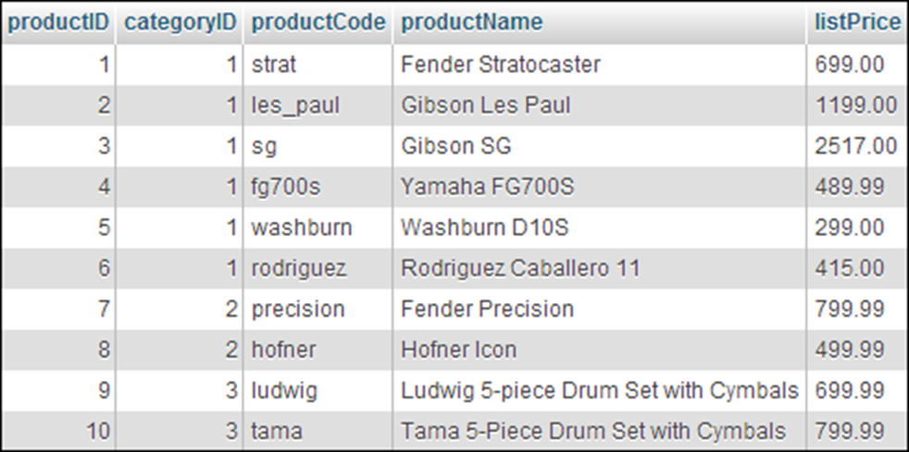
A products table

Slide 5
Key terms for relational database organization
relational database
table
row
column
record
field
cell
primary key
non-primary key
unique key

Slide 6
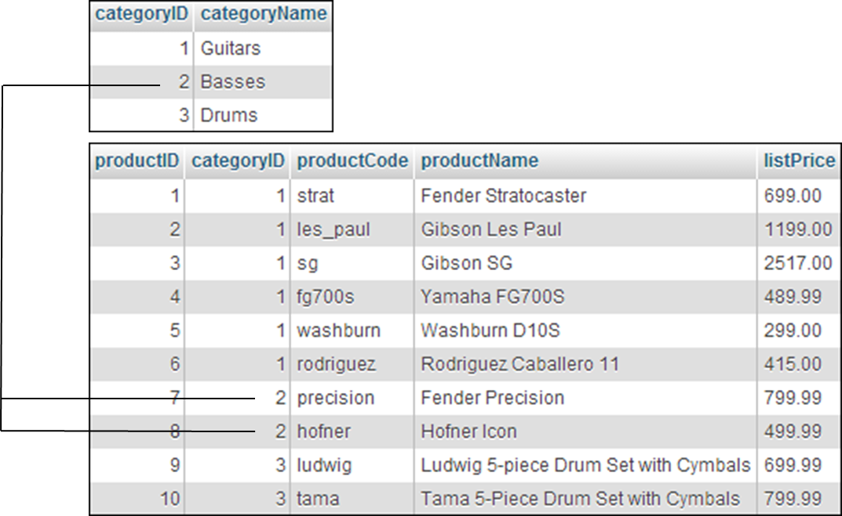
The relationship between two tables in a database through their primary and foreign keys

Slide 7
Key terms for table relationships
foreign key
one-to-many relationship
one-to-one relationship
many-to-many relationship

Slide 8
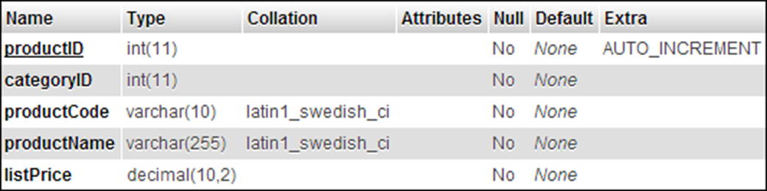
The columns of the products table

Slide 9
Common MySQL data types
CHAR
VARCHAR
INT
DECIMAL
DATE, TIME, DATETIME

Slide 10
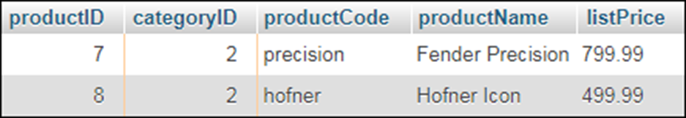
The SELECT statement syntax for all columns
SELECT * FROM table-1 [WHERE selection-criteria] [ORDER BY column-1 [ASC|DESC]
[, column-2 [ASC|DESC]] ...]
A SELECT statement that gets all columns
SELECT * FROM products
WHERE categoryID = 2
The result table

Slide 11
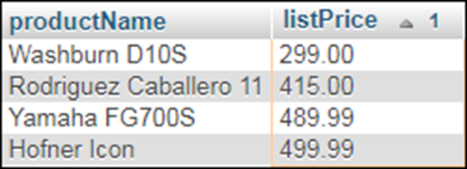
The syntax for selected columns
SELECT column-1 [, column-2] ... FROM table-1 [WHERE selection-criteria] [ORDER BY column-1 [ASC|DESC]
[, column-2 [ASC|DESC]] ...]
A statement that gets selected columns and rows
SELECT productName, listPrice FROM products WHERE listPrice < 500 ORDER BY listPrice ASC
The result table

Slide 12
The syntax that joins two tables
SELECT column-1 [, column-2] ... FROM table-1 {INNER | LEFT OUTER | RIGHT OUTER} JOIN table-2 ON table-1.column-1 = table-2.column-2 [WHERE selection-criteria] [ORDER BY column-1 [ASC|DESC] [, column-2 [ASC|DESC]] ...]

Slide 13
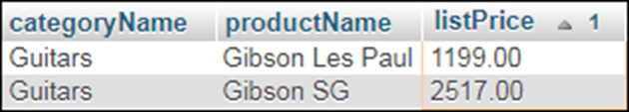
A statement that gets data from two related tables
SELECT categoryName, productName, listPrice
FROM categories
INNER JOIN products
ON categories.categoryID = products.categoryID
WHERE listPrice > 800
ORDER BY listPrice ASC
The result table

Slide 14
Key terms for joins
join
inner join
outer join
left outer join
right outer join

Slide 15
The syntax for the INSERT statement
INSERT INTO table-name [(column-list)] VALUES (value-list)
A statement that adds one row to a table
INSERT INTO products
(categoryID, productCode, productName, listPrice)
VALUES
(1, 'tele', 'Fender Telecaster', 599.00)
A statement that uses the MySQL NOW function to get the current date
INSERT INTO orders (customerID, orderDate)
VALUES (1, NOW())

Slide 16
The syntax for the UPDATE statement
INSERT INTO table-name [(column-list)] VALUES (value-list)
A statement that adds one row to a table
INSERT INTO products
(categoryID, productCode, productName, listPrice)
VALUES
(1, 'tele', 'Fender Telecaster', 599.00)
A statement that uses the MySQL NOW function to get the current date
INSERT INTO orders (customerID, orderDate)
VALUES (1, NOW())

Slide 17
The syntax for the DELETE statement
DELETE FROM table-name
WHERE selection-criteria
A statement that deletes one row from a table
DELETE FROM products
WHERE productID = 1
A statement that deletes multiple rows
DELETE FROM products
WHERE listPrice > 200

Slide 18
MySQL is…
Inexpensive
Fast
Easy to use
Portable

Slide 19
MySQL provides…
Support for SQL
Support for multiple clients
Connectivity
Security
Referential integrity
Transaction processing

Slide 20
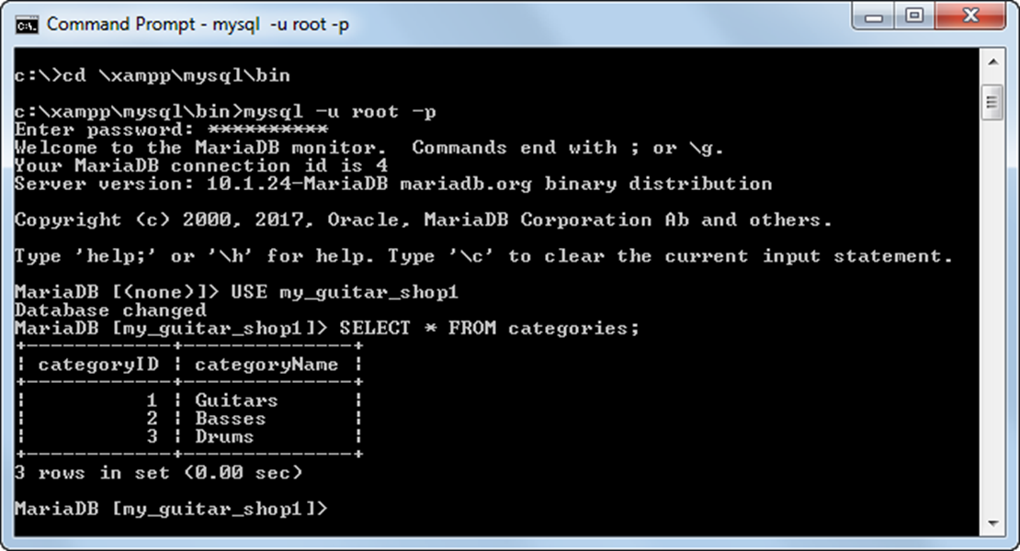
A command-line client

Slide 21
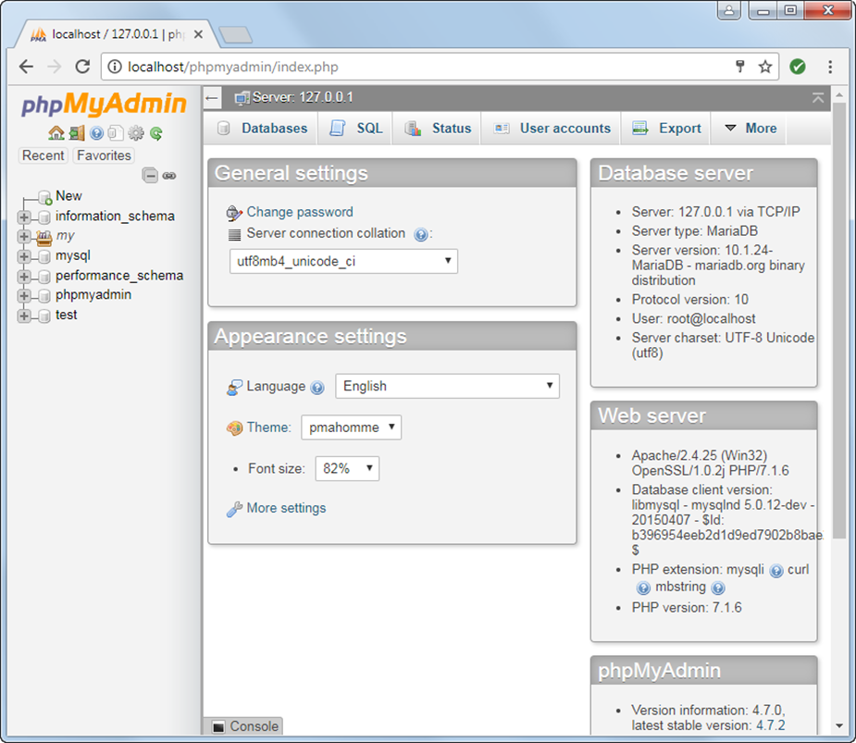
A web-based client

Slide 22
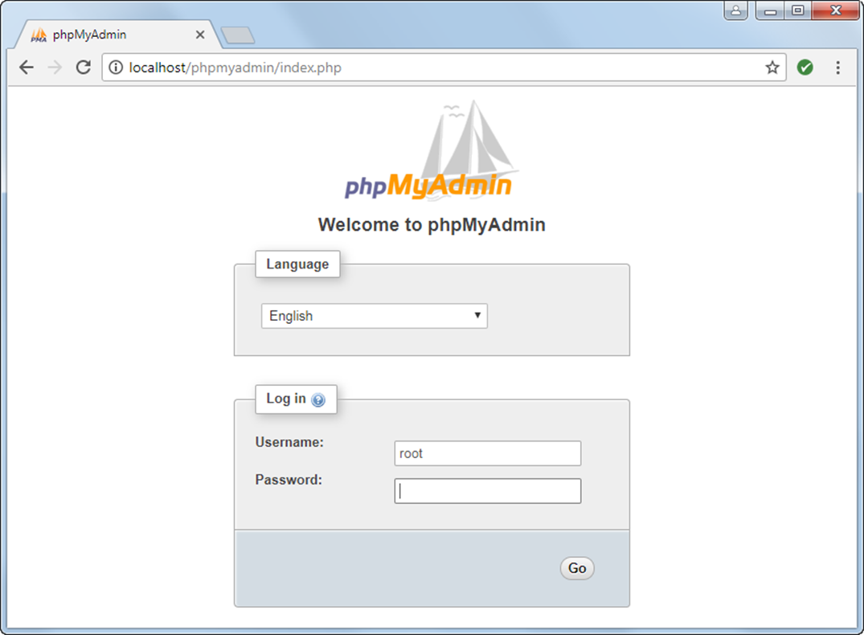
The Welcome page

Slide 23
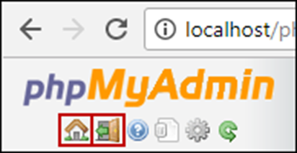
The Home and Logout buttons at the top of the sidebar on most pages

Slide 24
How to start phpMyAdmin on a local computer
From the XAMPP Control Panel, start the Apache and MySQL servers if they aren’t already running.
Click the Admin button for the MySQL module to start the phpMyAdmin tool in your default web browser.
How to log in
Enter your username and password.
How to log out and return to the Welcome page
Click the Log out button (the Exit sign icon).

Slide 25
How to change your password
Click the Home button (the house icon). Then, click the Change Password link in the General Settings box.
On the Change Password page, enter and re-enter your new password, and click the Go button.

Slide 26
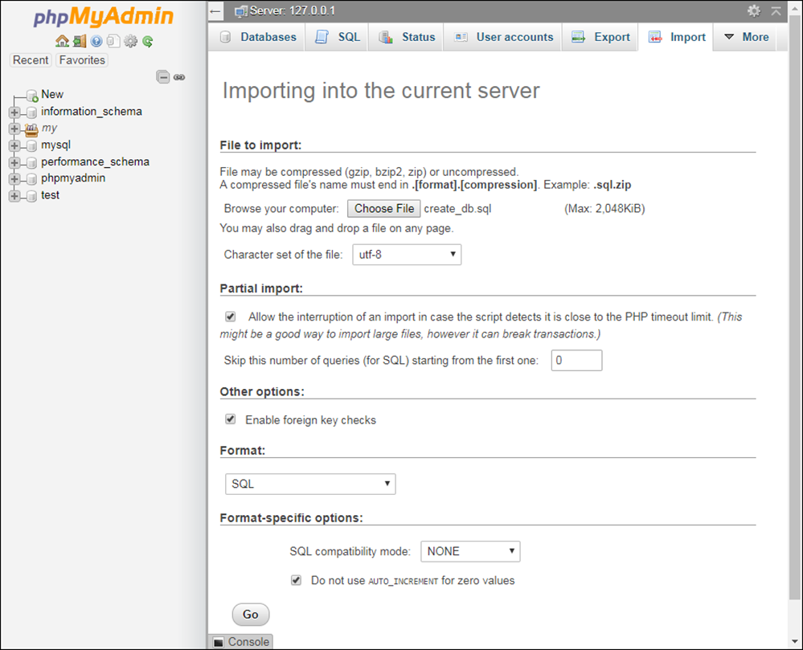
Running a SQL script that creates a database

Slide 27
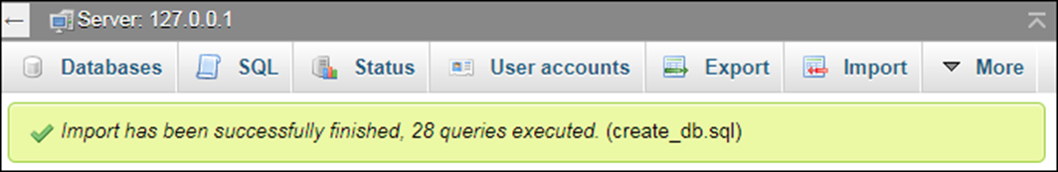
How to import and run a SQL script
Click the Import tab, go to the “File to Import” section, click the Choose File button, and select the file that contains the script.
Click the Go button. This runs the script that’s in the file.
A success message
The script for creating the databases for this book
\xampp\htdocs\book_apps\_create_db\create_db.sql

Slide 28
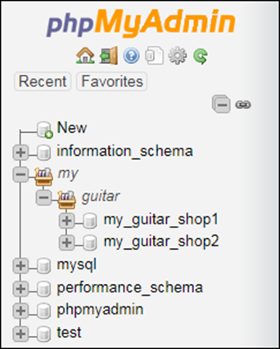
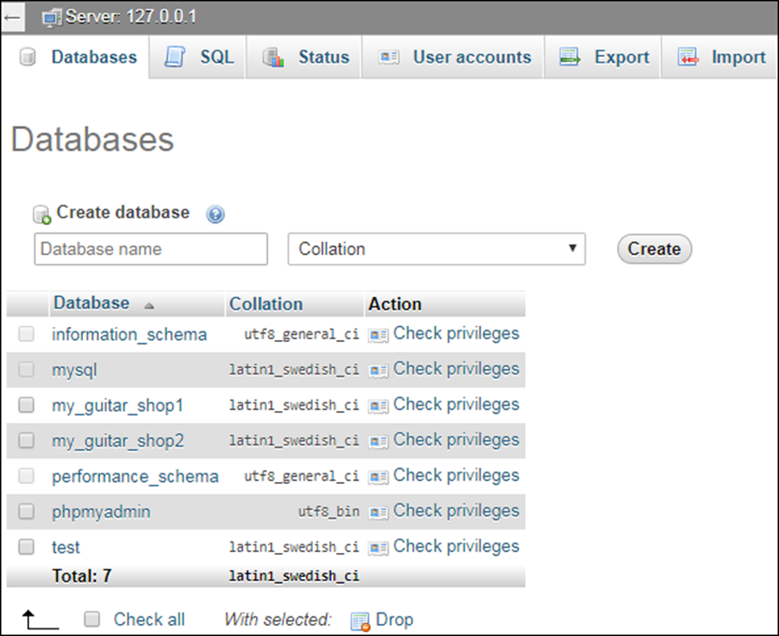
The databases tree and the Databases tab

Slide 29
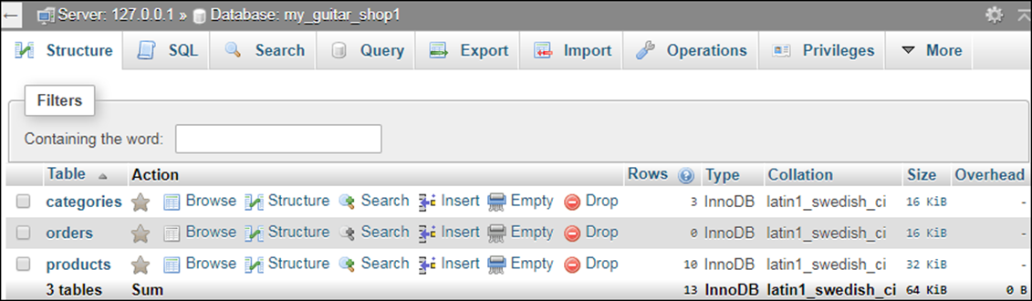
The Structure tab for the my_guitar_shop1 database

Slide 30
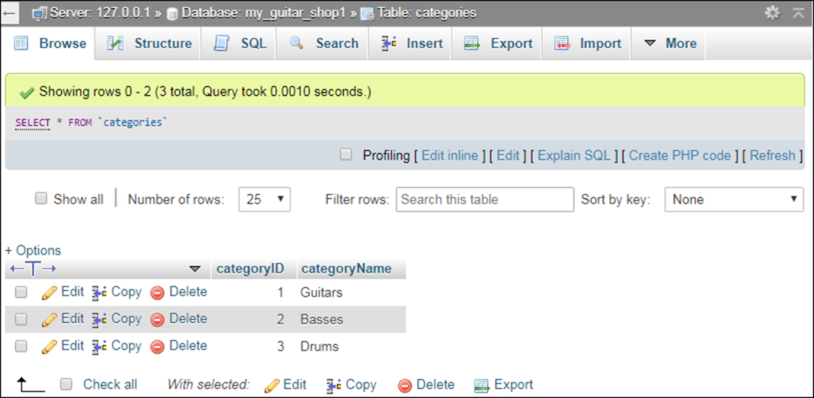
The Browse tab for the categories table

Slide 31
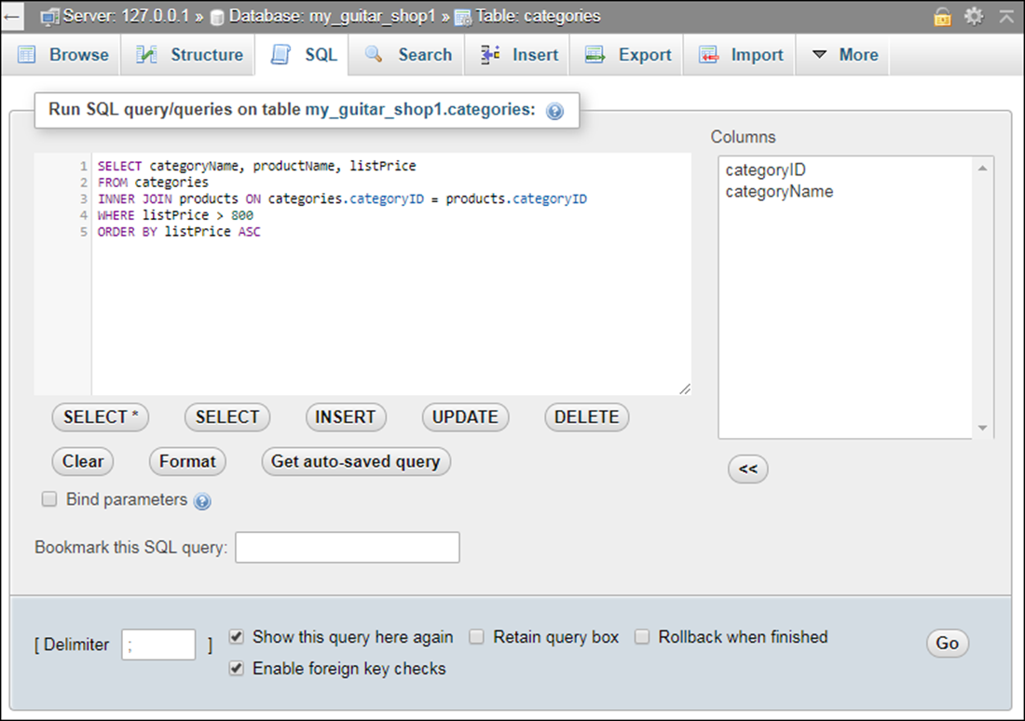
The SQL tab with a statement ready to run

Slide 32
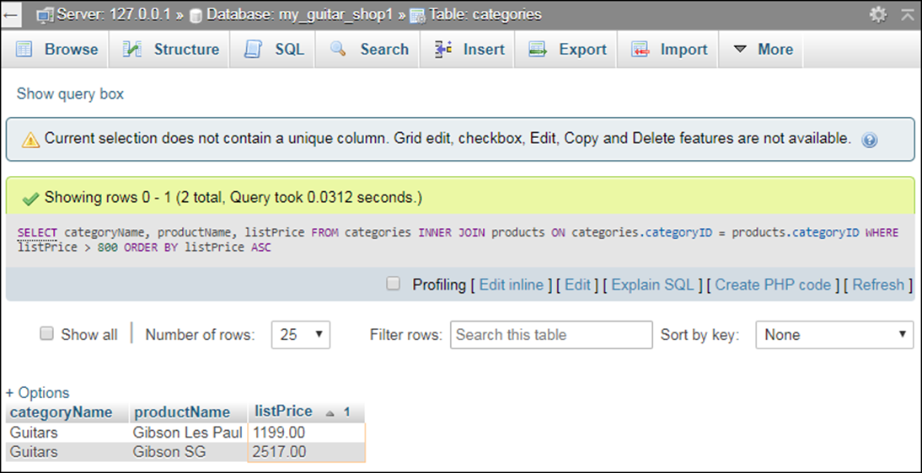
The result of the SQL statement

Slide 33
Creating a user with limited privileges on one table
GRANT SELECT
ON my_guitar_shop1.products
TO mgs_tester@localhost
IDENTIFIED BY 'pa55word'
Creating a user with limited privileges on all tables
GRANT SELECT, INSERT, DELETE, UPDATE
ON my_guitar_shop1.*
TO mgs_user@localhost
IDENTIFIED BY 'pa55word'

Slide 34
Common privileges
Privilege Description
SELECT Lets the user select data.
UPDATE Lets the user update data.
INSERT Lets the user insert data.
DELETE Lets the user delete data.
CREATE TABLE Lets the user create a table.
DROP TABLE Lets the user drop a table.

Slide 35
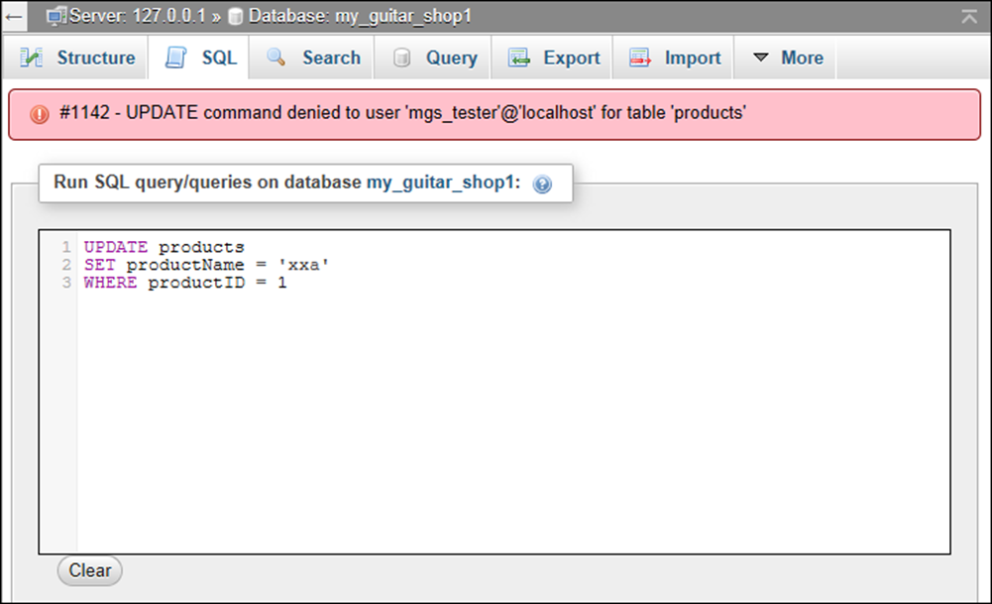
The error message that’s displayed after an UPDATE statement failed

